Slide 1
Capstone Project : Customer Behaviour and Retention Analytics
Capstone Project Summary
Authored by Eliud Mule

Slide 2
Project Overview
Purpose of the Project
Analyze 10,000 customers to understand the spending behaviour.
Identify drivers of churn.
Build data-driven retention strategies.

Slide 3
Phase 1 : Data Understanding and Cleaning
Data Audit and Cleaning.
Explore dataset(structure, summary, head)
The dataset contains 10000 observations and 15 variables, i.e eight numerical variables and nine categorical variables.
Identify missing values,duplicates,inconsistencies.
The dataset had nomissing values,duplicates ordata inconsistencies.

Slide 4
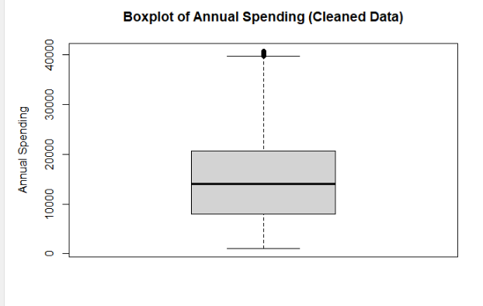
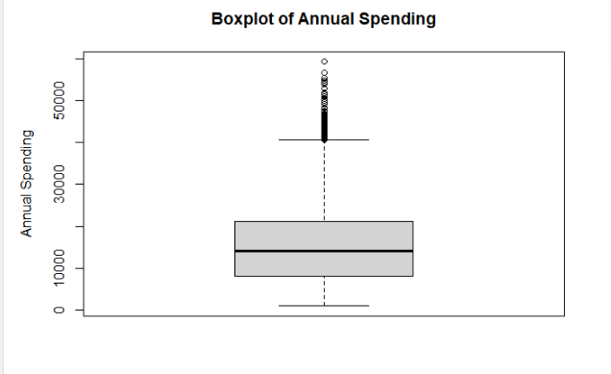
Outlier Detection and Treatment
Detected outliers using a Boxplot using two variables(Annual spending and credit score)
Both boxplots had outliers.
Used IQR method to remove the outliers then visualized the new boxplots.

Slide 5
Phase 2: Feature Engineering & Preprocessing.
Created new features using mutate function:
1.Spending to Income ratio(Annual spending/Annual income)
2.Customer tenure(Loyalty years *12)
3.Financial_stability Score(Credit score/Annual income)
Encoded categorical variables (education,gender,employment status, marital status,region,payment type,online shopper and churn) using One hot encoding.

Slide 6
Phase 3 : Exploratory Data Analysis(EDA)
Univariate Analysis:
Histogram for Annual Spending- The histogram of annual spending showed a right-skewed distribution, indicating that most customers have lower annual spending, while a smaller number of customers have higher annual spending.
Density Plot of Credit Score: The density plot of credit score shows a unimodal distribution, with most customers having credit scores around the mean, and fewer customers having very low or very high credit scores.
Frequency Table for Annual Income:Illustrated that the majority of customers fall within the lower income brackets, with a smaller proportion of customers in the higher income brackets

Slide 7
Multi-Variate Analysis
Boxplot of Spending by Region: The median annual spending and interquartile ranges appears to be relatively similar across all regions.
Boxplot of Annual Spending by Employment Status: Self_Employed customers tend to have higher median annual spending compared to employed,student,unemployed and retired customers. Additionally, the interquartile range for employed customers is wider, indicating greater variability in annual spending among this group. Unemployed and student customers have lower median annual spending and narrower interquartile ranges, suggesting that they generally spend less annually compared to employed customers.
Scatterplot of income vs credit score by churn:There was a positive correlation between annual income and credit score for both churned and non-churned customers. However, non-churned customers generally have higher credit scores compared to churned customers across all income levels. Additionally, there is an overlap in the scatterplot, indicating that there are some churned customers with high credit scores and some non-churned customers with low credit scores, suggesting that income and credit score alone are not strong predictors of customer churn, and other factors may also play a role in customer retention.
Correlation Heatmap : Annual spending has a strong positive correlation with annual income (r = 0.83), indicating that customers with higher incomes tend to spend more annually. Additionally, there is a moderate positive correlation between credit score and annual spending (r = 0.63), suggesting that customers with higher spendings also tend to have better credit scores.

Slide 8
Phase 4 : Descriptive Statistics & Inference
1.Summary Statistics
Computed summary statistics( Mean, Median, SD, IQR) for Annual Spending across various groups :
i. Summary statistics for Annual spending by region-The summary statistics for annual spending by region indicate that suburban customers have the highest mean and median spending, followed by urban and rural customers. The standard deviation of annual spending is however, highest for rural customers, suggesting greater variability in spending among this group. The interquartile range (IQR) is also widest for rural customers, indicating a larger spread of annual spending values compared to suburban and urban customers.
ii.Summary Statistics for Annual Spending by Employment Status-The summary statistics for annual spending by employment status reveal that self-employed customers have the highest mean and median annual spending followed by employed customers . Unemployed and student customers have significantly lower mean annual spending. The standard deviation and interquartile range indicate that there is greater variability in annual spending among self-employed customers compared to other employment statuses.
iii.Summary Statistics for Annual Spending by Education level-The summary statistics for annual spending across different education levels indicate that customers with a PhD degree tend to have the highest mean and median annual spending, followed by those with a master's degree,bachelor's degree,diploma and lastly high school education. Additionally, the standard deviation and interquartile range for annual spending follows the same trend, suggesting greater variability in spending among Phd's group compared to other education levels

Slide 9
Confidence Intervals
Constructed 95% Confidence intervals
Interpretation:The mean annual spending was estimated to be approximately 14880.91 with a 95% confidence interval ranging from 14703.63 to 15058.19. The interval does not include zero,indicating statistical significance at the 5% level. In addition, the confidence interval was relatively narrow, suggesting a precise estimate of the mean annual spending for the customer base.

Slide 10
Phase 5 : Hypothesis Testing Part A: Parametric Tests
1.Two sample t-test for Annual spending by churn : there was a statistically significant difference in mean annual spending between churned and non-churned customers (p-value = 0.00001196). The mean annual spending for non-churned customers was higher than that of churned customers, suggesting that customers who do not churn tend to spend more annually compared to those who do churn.
2.Anova with Post-hoc Analysis(Annual Spending ~Region)
Anova results:Indicated a small significant difference in mean annual spending across different regions.
Post-hoc Analsis :there was no statistically significant difference in mean annual spending between any pair of regions, as all p-values were greater than 0.05. This suggests that while the ANOVA indicated a significant difference across regions, the post-hoc analysis does not identify any specific pairs of regions that differ significantly from each other in terms of annual spending. Therefore, we can conclude that regional location does not have a significant impact on customers' annual spending behavior in this dataset when comparing specific regions to each other.

Slide 11
Part B : Non-Parametric Tests
1.Mann-Whitney U test for Annual Spending by Churn: The results with a p-value of 0.3673 indicate that there is no statistically significant difference in median annual spending between different marital statuses.
2.Kruskal-Wallis Test for Annual Spending by Region :The results with a p-value of 0.0575 indicate that there is no statistically significant difference in median annual spending across different regions at the 5% significance level.
3.Chi-square test
-Created a contingency table for churn and region then performed the test.
Results: The results above with a p-value of 0.5805 indicate that there is no statistically significant association between customer churn and region. This implies that regional location does not have a significant impact on customer churn behavior.

Slide 12
Part 6 : Regression Modeling Part A : Simple Linear Regression
Simple linear regression for Annual spending by Annual income:The model was statistically significant (p-value = 2e-16), suggesting that annual income is a significant predictor of annual spending in this dataset. However, the R-squared value of 0.6827 indicates that approximately 68.27% of the variance in annual spending can be explained by annual income while the adjusted R-squared value of 0.6827 suggests that the model has a good fit to the data, accounting for the number of predictors included in the model.

Slide 13
Residual Diagnostics of The SLR Model
Generated Diagnostic plots and performed various tests.
1.Linearity test-The results with a p-value of < 0.05 indicated that we reject the null hypothesis, suggesting that there is non linearity in the relationship between annual income and annual spending.
2. Anderson-Darling test for normality of residuals-The results with a p-value of < 0.0001 indicated that we reject the null hypothesis, suggesting that the residuals from the regression model are not normally distributed.
3. Breusch-Pagan test for homoscedasticity-The results with a p-value of < 0.05 indicated that we reject the null hypothesis, suggesting that there is heteroscedasticity in the residuals of the regression model.
4.Outliers and Influential points-From the plot of residuals vs leverage, there were potential outliers and influential points in the regression model.

Slide 14
Part 2 : Multiple Linear Regression
Dependent Variable: Annual Spending
Independent Variables : Annual income, credit score, loyalty years, age, region, employment status, and online shopper status.
Results of the MLR model: The multiple linear regression model indicates that only annual income is a statistically significant predictor of annual spending (p-value < 0.001), while credit score, loyalty years, age, region, employment status, and online shopper status do not have a statistically significant effect on annual spending (p-values > 0.05). The R-squared value of 0.6829 indicates that approximately 68.29% of the variance in annual spending can be explained by the independent variables included in the model, while the adjusted R-squared value of 0.6826 suggests that 68.26% of the variance in annual spending can be explained by annual income,credit score, loyalty years, age, region, employment status, and online shopper status, after adjusting for the number of predictors in the model.

Slide 15
Multicollinearity
Checked for multicollinearity(VIF) in the MLR Model.
Results: The VIF values for all predictors in the multiple linear regression model are below the commonly used threshold of 5, indicating that there is no significant multicollinearity among the independent variables. This suggests that the predictors are not highly correlated with each other, and the model can provide reliable estimates of the coefficients without concerns of inflated standard errors due to multicollinearity.

